Slide 1
Digital Portfolio
STUDENT NAME: DINESH KUMAR L
REGISTER NO AND NMID: 2422J0773&DINESHKUMARLNM2422J0773@GMAIL.COM
DEPARTMENT: BCA
COLLEGE: COLLEGE/ UNIVERSITY:GOVERNMENT ARTS AND SCIENCE SATHYAMANGLAM,638401,ERODE/BHARATHIAR UNIVERSITY

Slide 2
PROJECT TITLE
DIGITAL PORTFOLIO

Slide 3


AGENDA
Problem Statement
Project Overview
End Users
Tools and Technologies
Portfolio design and Layout
Features and Functionality
Results and Screenshots
Conclusion
Github Link
3/21/2024 Annual Review

Slide 4

PROBLEM STATEMENT
• Header (sticky) → Your name and navigation links (About, Projects, Contact).
• About Section → A short intro about your skills (HTML, CSS, JavaScript, React).
• Projects Section → Three project cards (Portfolio Website, Todo App, E-commerce Website) with hover effects and
“View Project” buttons.
• Contact Section → Email, LinkedIn, and GitHub links.
• Footer → Copyright notice

Slide 5

PROJECT OVERVIEW
The project is a personal portfolio website designed to showcase the work, skills, and contact details of a web developer named Abishek. It features an About section introducing the developer and highlighting skills (HTML, CSS, JavaScript, React), a Projects section that displays sample projects (such as a Portfolio Website, Todo App, and E-commerce Website), and a Contact section with ways to reach the developer via email, LinkedIn, or GitHub. The site uses a clean, responsive layout and interactive elements, providing a professional digital presence for potential employers, clients, or collaborators

Slide 6

WHO ARE THE END USERS?
* Potential employers or recruiters seeking to evaluate the work, skills, or projects of the web developer.
* Clients or collaborators interested in hiring or working with the web developer for web projects.
Other developers or peers who wish to review the showcased projects for collaboration, feedback, or * inspiration

Slide 7

TOOLS AND TECHNIQUES
HTML, CSS, and JavaScript: The foundational technologies for all the showcased projects and the portfolio itself.
React: Identified as a core skill, suggesting usage for interactive and dynamic user interfaces.
Responsive web design: Indicated by a focus on building clean and responsive websites.
Project Showcase: Examples include a Todo App (task manager using HTML, CSS, JavaScript), an E-commerce mock store, and the portfolio itself.
UI/UX best practices: Implied through emphasis on user-friendly, visually clean websites and cards with interactive effects (like hover states).

Slide 8
POTFOLIO DESIGN AND LAYOUT
Section-based Layout: Each major area (About, Projects, Contact) is organized into its section with clear headings.
Projects Grid: Projects are shown as cards in a responsive grid layout. Each card includes a title, short description, and a “View Project” button.
Consistent Styling: Utilizes a sans-serif font, ample padding, and a neutral color scheme (light backgrounds with darker text and contrasting buttons).
Interactive Elements: Cards have hover effects and buttons change color on hover for a dynamic user experience.
Footer: Simple and centered, including copyright information.
8

Slide 9
FEATURES AND FUNCTIONALITY
Navigation Bar: Sticky header navigation allows users to jump to About, Projects, and Contact sections.
About Section: Summarizes the developer's skills (HTML, CSS, JavaScript, React) and passion for building real-world solutions.
Projects Section: Interactive project showcase grid. Each project is presented as a card with a title, description, and a “View Project” button for more details.
Contact Section: Provides email, LinkedIn, and GitHub contact links for easy communication and networking.
Responsive Design: Layout adapts to various device widths for optimal mobile and desktop viewing.
Interactive UI Elements: Cards and buttons with hover effects to improve user engagement and experience.
Footer: Displays copyright information

Slide 10
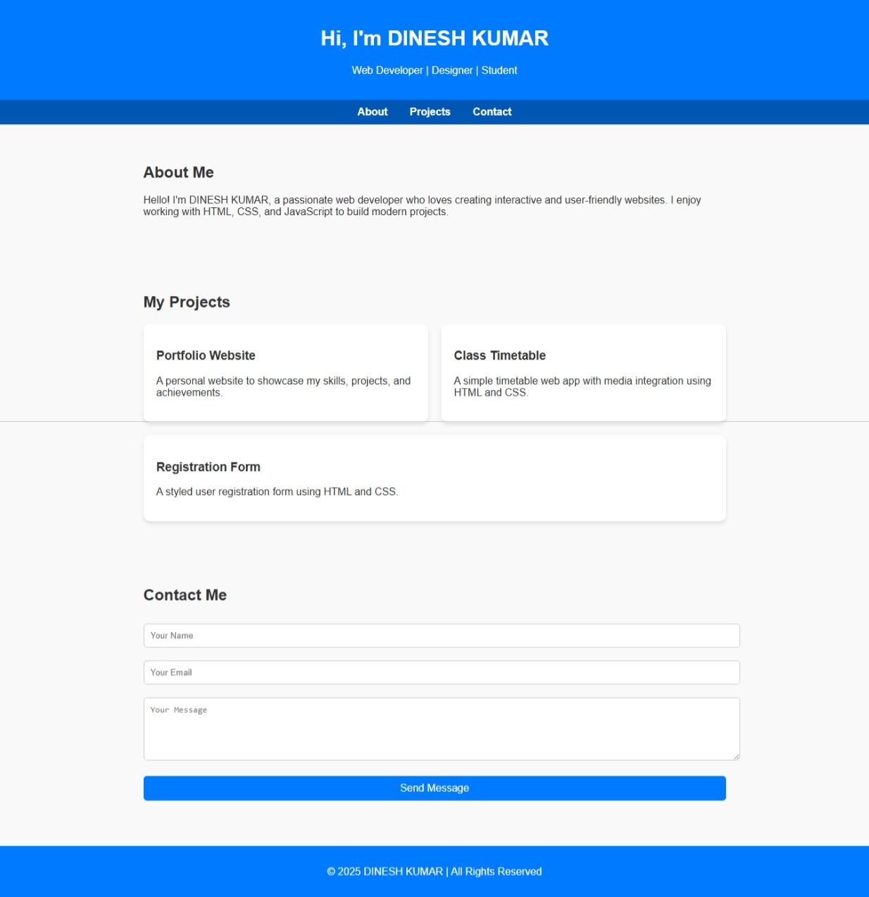

RESULTS AND SCREENSHOTS
3/21/2024 Annual Review
10

Slide 11
CONCLUSION
The portfolio project successfully demonstrates the developer's expertise in key web development technologies such as HTML, CSS, JavaScript, and React. It provides an intuitive and visually appealing design that effectively communicates skills, showcases projects, and facilitates easy contact. The structured layout and responsive design ensure accessibility and a positive user experience across devices. Overall, this portfolio serves as a professional and efficient platform for attracting potential employers, collaborators, or clients by clearly reflecting the developer’s capabilities and style
11

